Slide 1

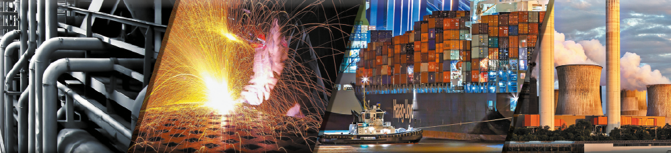
Insulation Fixing Systems

Slide 2
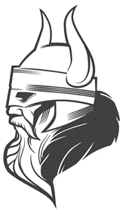
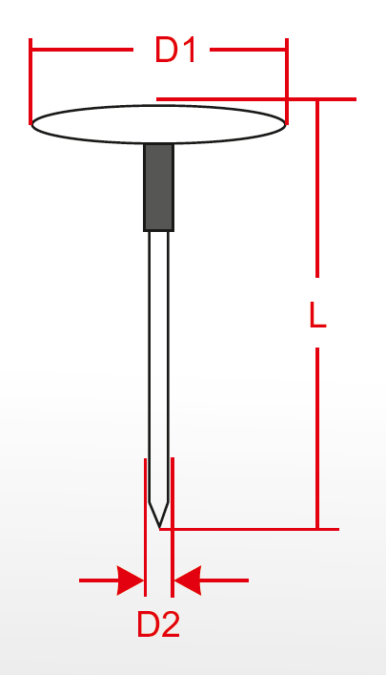
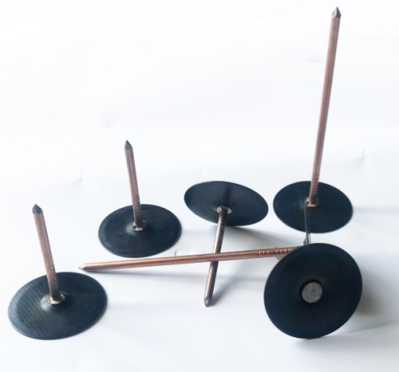
HVAC INSTALLATIONS
Head Pins without insulation
Fasteners allow the fixing in
a single operation of non-aluminum
faced insulation such as lamella mats
or wired mats to the metal surfaces.
D1 (mm) - 30
D1 (mm) - 30
D2 (mm) - 2,7
D2 (mm) - 2,2
L (mm) - 19÷250
L (mm) - 19÷250
Head Pins with insulation
Insulated fasteners allow the fixing
in a single operation of aluminum
faced insulation such as lamella mats
or wired mats to the metal surfaces.
D1 (mm) - 30
D1 (mm) - 30
D2 (mm) - 2,7
D2 (mm) - 2,2
L (mm) - 19÷250
L (mm) - 19÷250
Head Pin Black with insulation
Insulated fasteners allow the fixing
in a single operation of black aluminum
faced insulation such as lamella mats
or wired mats to the metal surfaces.
D1 (mm) - 30
D1 (mm) - 30
D2 (mm) - 2,7
D2 (mm) - 2,2
L (mm) - 19÷250
L (mm) - 19÷250

Slide 3
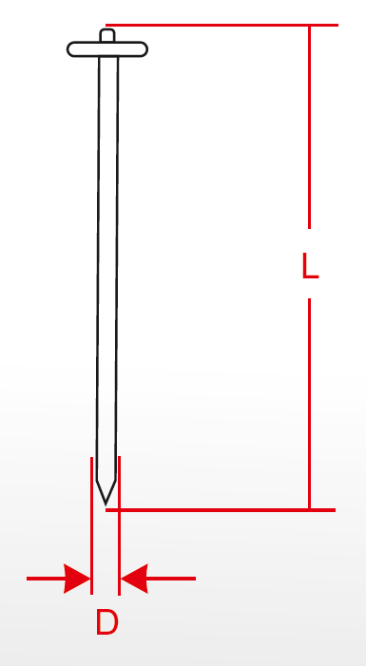
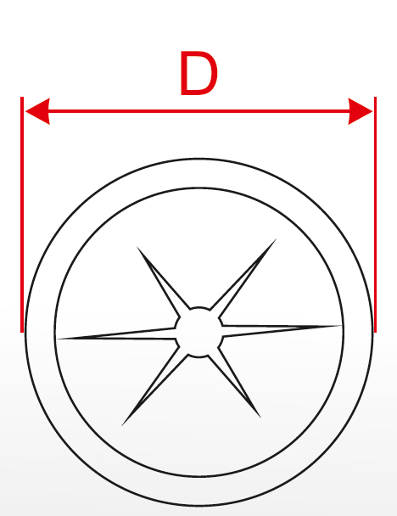
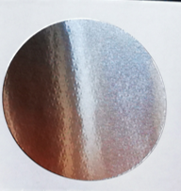
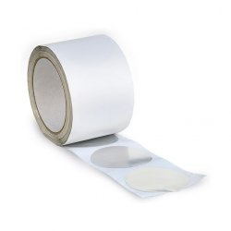
HVAC INSTALLATIONS
CD Pins without insulation
Used to fix thermal and acoustic insulation
to the air ducts or other steel constructions.
D1 (mm) - 30
D1 (mm) - 30
D2 (mm) - 2,7
D2 (mm) - 2,2
L (mm) - 19÷250
L (mm) - 19÷250
Pin washer
Used to make sure that the insulation
material applied is held securely in place.
D1 (mm) - 30
D1 (mm) - 30
Pin size (mm) - 2,2 / 2,7 / 3
D2 (mm) - 2,2
L (mm) - 19÷250
Alu Spots
Aluminum Spots the optimal solution when it comes to cover pins heads. This is fast in installation, clean, a good looking, smooth, gapless and tight insulation surface. Delivered on the rolls.
Spot diameter (mm) - 60
D1 (mm) - 30
Spots on roll (pcs) - 750
D2 (mm) - 2,2
Rolls per box (pcs) - 8
L (mm) - 19÷250

Slide 4
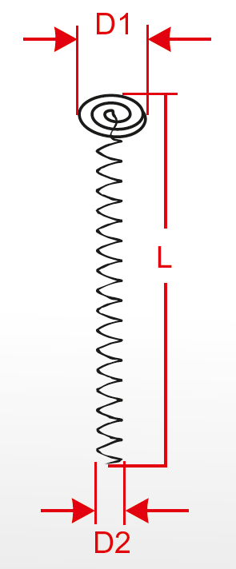
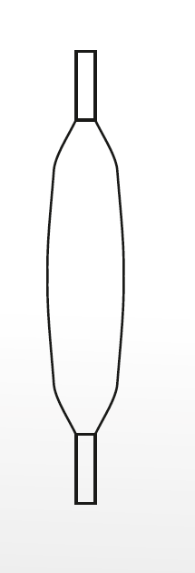
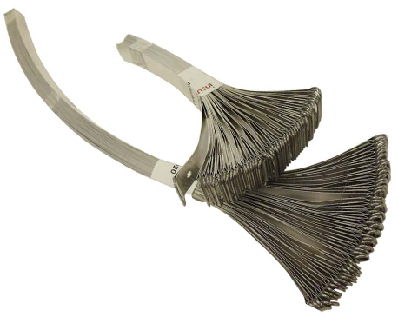
HVAC INSTALLATIONS
Fire Springs
A spiral screw made from galvanized steel wire coil.
It is used to connect edges of fire protection boards.
D1 (mm) - 20
D1 (mm) - 30
D2 (mm) - 8
D2 (mm) - 2,2
L (mm) - 60 / 90 / 120 / 160 / 200
L (mm) - 19÷250
Lancing wire
Galvanized wire .
D (mm) - 0,6
D1 (mm) - 30
Weight (g) - 100
D2 (mm) - 2,2
Material - St 37
L (mm) - 19÷250
Alu Bands
Pre-cut aluminum bands for pipe section and lamella mats installation.
Spot diameter (mm) - 60
D1 (mm) - 30
Spots on roll (pcs) - 750
D2 (mm) - 2,2
Soon in the offer
Rolls per box (pcs) - 8
L (mm) - 19÷250

Slide 5
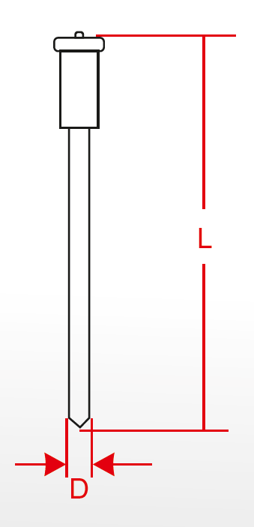
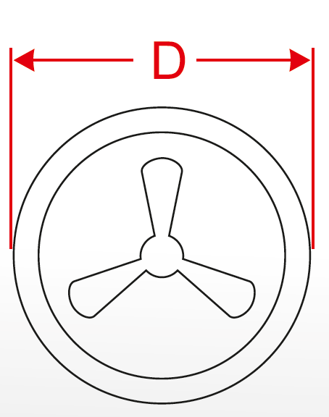
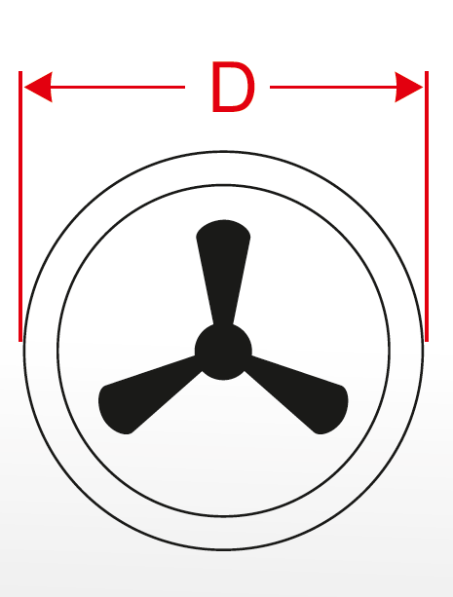
MARINE CONSTRUCTION
VBS Studs
Insulation studs VBS are used to fix
thermal and acoustic insulation to the aluminum
constructions (such as walls and decks).
D (mm) - 3
D1 (mm) - 30
D2 (mm) - 2,2
L (mm) - 30÷1000
L (mm) - 19÷250
Stud washer
Stud self-locking washers for securing
insulation on the studs.
D (mm) - 38
D1 (mm) - 30
Stud diameter (mm) – 3 / 4 / 5 / 6
D2 (mm) - 2,2
L (mm) - 19÷250
Dome cups
Additional cover for the stud washers serves both
a protective and decorative purpose.
D (mm) - 43
D1 (mm) - 30
Stud diameter (mm) – 3 / 4 / 5 / 6
D2 (mm) - 2,2
Colours – white, black, gray
L (mm) - 19÷250

Slide 6
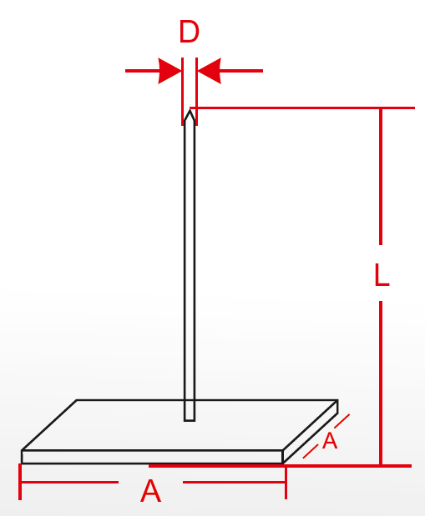
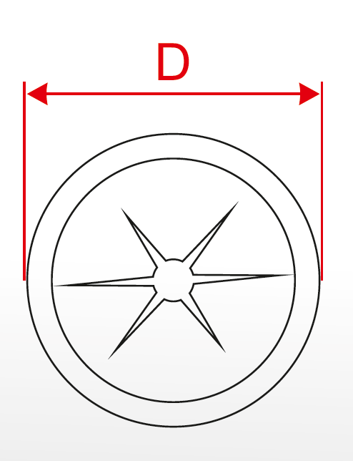
MARINE CONSTRUCTIONS
Self Adhesive Pins
Insulation pin with a self-stick base intended
to mount the insulation to steel duct surface.
D (mm) - 2,7
D1 (mm) - 30
A (mm) - 50x50
D2 (mm) - 2,2
L (mm) - 19÷240
L (mm) - 19÷250
Perforated Pins
An universal pin for insulation assembling.
Quick and uncomplicated fixing of insulation
on smooth, rough and uneven surfaces
(e.g. concrete, masonry, metal).
D (mm) - 2,7
D1 (mm) - 30
A (mm) - 50x50
D2 (mm) - 2,2
L (mm) - 19÷240
L (mm) - 19÷250
Pin washer
Washers for hold insulation on the pins.
D1 (mm) - 43
D1 (mm) - 30
For stud clips
D2 (mm) - 2,2
L (mm) - 19÷250
L (mm) - 19÷250

Slide 7
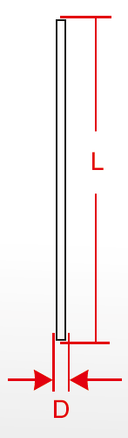
INDUSTRIAL CONSTRUCTIONS
ARC Stud
Insulation stud ARC are used when working
with tanks, boilers and other steel and stainless
steel constructions.
D (mm) - 3 / 4 / 5 / 6
D1 (mm) - 30
D2 (mm) - 2,2
L (mm) - 30÷3000
L (mm) - 19÷250
ISN Stud
Insulation stud ISN - for steel
or stainless steel construction.
D (mm) - 2 / 3 / 4
D1 (mm) - 30
D2 (mm) - 2,2
L (mm) - 30÷245
L (mm) - 19÷250
Stud washer
Washers for hold insulation on the studs.
D (mm) - 38
D1 (mm) - 30
Stud diameter (mm) – 3 / 4 / 5 / 6
D2 (mm) - 2,2
L (mm) - 19÷250

Slide 8
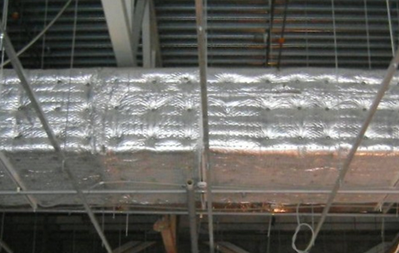
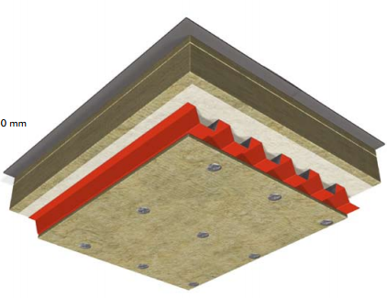
Right pin length
Depending on the final effect you may use two different length of the pins.
Quilted surface
For the products up to 50 kg/m3 use the pins with the length little bit smaller than nominal insulation thickness
(example: for insulation thickness 30mm use 28,5 mm pins) .
Flat surface
For all densities use the pins with the length little bit higher than nominal insulation thickness
(example: for insulation thickness 30mm use 33 mm pins).

Slide 9
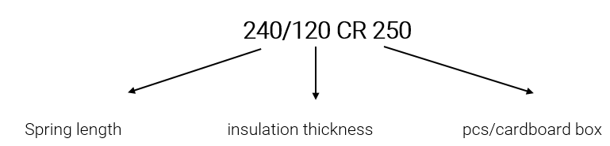
Fire Springs
Typical Fire Springs lengths: 30, 40, 50, 60, 80, 100, 120.
Fire Springs - description

Slide 10
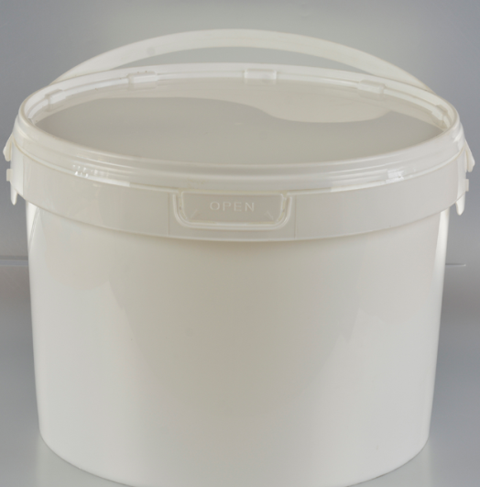
How to place on order
Information needed when ordering:
Pins – product name, with or without insulation, length, number of buckets/boxes (MOQ 1000pcs),
Studs – product name, diameter, length, material
Fire Springs - length, number of boxes (MOQ 250, 500pcs),

Slide 11
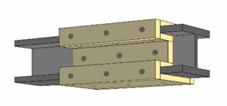
Welding on protected surfaces
Protective coatings are the most widespread solution for protecting steel against corrosion. Anti-corrosion primer is generally applied immediately after steel is manufactured in order to prevent rusting during storage and transportation, and before further processing (cutting, welding, pinning, drilling, etc.).
The recommended anti-corrosion primers are often too thick (~50μm) for welding and need to be removed before welding or pinning. Removal is usually performed by grinding.
There is possible to find new primer products on the market which claim to provide good corrosion protection and to be weldable. These products often need to be applied in thin layers to be weldable (about 25 microns thick coating to enable an arc to strike through and reduce the chances of porosity due to their zinc content).Where primers are thin enough (~25μm) to allow welding, their anti-corrosion properties are limited that it does not reduce the corrosion. That is why they are not often used.

Slide 12
